Slide 1
Object-Oriented Middleware

Slide 2
“naïve” RPC vs. OO middleware
“Naïve” RPC call example:
Call Debit(012345678, 100);
OO example:
Call AccountSet.GetAccount(012345678, 100) return acctRef;
Call acctRef.Debit(100);
Common OO usage
Call AccountSet.GetAccount(012345678, 100) return acctRef;
Call acctRef.GetNameAndBalance(…);
Call acctRef.Debit(100);
Notes:
The big difference here is that in OO middleware we have to deal with the problem of initially getting a reference to the remote object that we are going to call.

Slide 3
Object-Oriented Middleware
Why use OO middleware? Isn’t RPC simpler?
Most software these days is designed as OO.
The advantages of polymorphism – replace components behind the interface.
RPC paradigm is not object-oriented
invoke functions on servers as opposed to methods on objects
With OO middleware, objects can be invoked in a compiled run-time environment or an interpreted one.

Slide 4
Objects
Object encapsulates data, the state
Object encapsulated methods, operations on the data
Methods are made available thru well-defined interfaces
In distributed environment
Interface can be on one machine and
Corresponding object on another machine

Slide 5
Local Objects
Within one process’ address space
Object
consists of a set of data and a set of methods.
E.g., C++ object, Java object.
Object reference
an identifier via which objects can be accessed.
i.e., a pointer (e.g., virtual memory address within process)
Interface
provides a definition of the signatures of a set of methods (i.e., the types of their arguments, return values, and exceptions) without specifying their implementation.

Slide 6
Remote Objects
May cross multiple process’ address spaces
Remote method invocation
method invocations between objects in different processes (processes may be on the same or different host).
Remote Procedure Call (RPC): procedure call between functions on different processes in non-object-based system
Remote objects
objects that can receive remote invocations.
Remote object reference
an identifier that can be used globally throughout a distributed system to refer to a particular unique remote object.
Remote interface
Every remote object has a remote interface that specifies which of its methods can be invoked remotely. e.g., CORBA interface definition language (IDL).

Slide 7
A Remote Object and Its Remote Interface
remote
object
remote
Data
interface
m4
{
m1
implementation
m2
m5
m3
of methods
m6
Example Remote Object reference=(IP, port, objectnumber, signature, time)

Slide 8
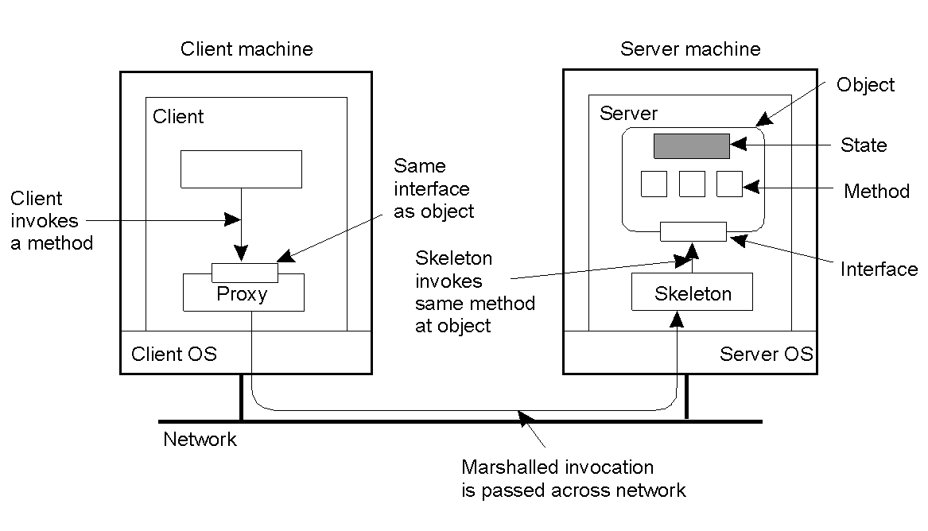
Distributed Objects
Interface on client
Proxy ⎯ like client stub in RPC
Object on server
Skeleton ⎯ like server stub in RPC

Slide 9
Object-Oriented Middleware (OOM)
Objects can be local or remote
Object references can be local or remote
Remote objects have visible remote interfaces
Masks remote objects as being local using proxy objects
Remote method invocation
local
OOM
OOM
remote
object
request
broker
/
object
manager
object
request
broker
/
object
manager
object A
skeleton
object B
proxy
object B
object B

Slide 10
Distributed object management
Emphasis is on interoperability
Allows objects on one host to invoke methods of objects on another host
Platform, language independent
Interoperability
Client
Server
Client object can invoke methods of server object, even if they are running on different platforms, written in different languages
Interoperability also requires:
Common structure of data
Common interpretation of data
Agreement on protocols

Slide 11
Before and after
Distributed application
Before
OS 1
OS 2
OS 3
IP
Distributed application
After
Distributed object management middleware
OS 1
OS 2
OS 3
Spanning
layer
IP
Notes:
Goal: make heterogeneous distributed environment appear homogeneous to the application programmer
CORBA is an acronym for “Common Object Request Broker Architecture”, and is being advanced by the Object Management Group (OMG), a consortium of over 700 software companies.
DCOM is an acronym for “Distributed Common Object Model”, and is promulgated by Microsoft.
CORBA and DCOM are motivated by the needs of electronic commerce, where network effects are strong.
CORBA emphasizes interoperability, but currently does not emphasize portability. In this sense CORBA and Java are complementary, since Java emphasizes portability

Slide 12
Distributed Objects
Client
Application
Server
Application
invoke
method
Execute
method
Client proxies
Server skeletons
ORB
ORB
Network Protocol Stack
Network Protocol Stack
ORB (Object Request broker) enables client applications to remotely instantiate, locate, invoke methods and delete server objects; Java RMI, Microsoft’s DCOM; CORBA is meant to be platform independent.
Notes:
RPC stubs and runtime enable location transparency, encapsulate RPC comm infrastructure and provide a proceudre call interface.

Slide 13
Object-Oriented Middleware
Map object references to hosts
Object adapters need to be able to start up servers, which register in an implementation repository or registry
Implement operation dispatch
Implement synchronization
Object Request Broker
Object Reference
Hosts
Processes
Objects

Slide 14
ORB Architecture
ORB!
Request
Service
activate
Service
Establish
connection
Client
Remote Service
(object)
communicate
Think of an object request broker as a name service for objects.
The server process registers its service with the ORB.
The client contacts the ORB asking where it can find the service (resolving the location).
But then the ORB takes us one step further, and actually sets up the client-server connection.
The best part is that the developer never has to worry about any of this. To the programmer, the call looks like it is local to the client.
Notes:
The client makes a request to the ORB to find and bind to the needed service. The ORB finds the service, establishes a connection between the client and server processes and finally activates the service.
The ORB allows the server to hide implementation details from the client. The client never has to know what programming language was used, what operating system the process is running on, what hardware architecture the host has, or even the location of the object.

Slide 15
Developing with Object-Oriented Middleware
Design
Interface Definition
Server Stub Generation
Client Stub Generation
Server Coding
Client Coding
Server Registration

Slide 16
Implementation of Client Objects
An object request is made by a client calling a local method of a client stub
Stubs can achieve access transparency
Middleware may shortcut a stub if server and client reside on the same host

Slide 17
Implementation of Server Objects
The generated server stub has to call the server implementation that an application builder designed.
<<uses>>
Player_Dispatch
<<Interface>> Player_Imp
<<Implements>>
Player_Server
Interface

Slide 18
Server Registration
Server object must be registered
Registry
Implementation repository
System administrator maintain the repository
Middleware provide tools for maintaining the repository
Register new server objects
Startup server objects
Stop/delete existing server objects

Slide 19
CORBA

Slide 20
Why CORBA?
Need to share information and resources within and across diverse computing enterprises
CORBA is a Middleware Standard
CORBA is a “Software Bus”
CORBA is a Distributed Object Architecture

Slide 21
CORBA
Common Object Request Broker Architecture
Open standard by the OMG (Version 3.0)
Language and platform independent
Object Request Broker (ORB)
General Inter-ORB Protocol (GIOP) for communication
Interoperable Object References (IOR) contain object location
CORBA Interface Definition Language (IDL)
Stubs (proxies) and skeletons created by IDL compiler
Dynamic remote method invocation
an intermediary handling requests in a system
facilitates communication between clients and server objects
separates a component’s interface from its implementation
Interface Repository
Querying existing remote interfaces
Implementation Repository
Activating remote objects on demand

Slide 22
CORBA architecture
Client
objects
Server objects
Object
adapter
Object request broker core
Interface
repository
CORBA services

Slide 23
CORBA Objects
A CORBA Object has an interface and an implementation
Client objects in CORBA do a “remote method invocation (RMI)” on server objects. (Under different circumstances, a single object instance can be either a client or server.)
The object adapter manages the life cycle of objects in its domain, such as instantiating them, destroying them, directing RMI’s at them, etc.
The interface repository stores browsable descriptions of all object interfaces, argument and return value interfaces, etc. This is called object metadata, meaning “data about the data”.
Interface is not bound to a specific implementation programming language

Slide 24
CORBA is a Middleware Standard
Before CORBA, middleware was dominated by proprietary tools
CORBA provides a standard that allows you to:
Develop applications using a common basis
Change CORBA products with minimal rewriting of code
Make objects running on different CORBA products interoperate
Integrate third-party products that respect the standard
CORBA is evolving to standardize other types of middleware

Slide 25
How Does CORBA Work?
Step 1: Write a specification for each object using IDL (Interface Definition Language)
Step 2: Compile the IDL to generate client stub and server skeleton code
Step 3: Write the client application code.
Step 4: Write the server object code.
Step 5: Compile the client and server code
Step 6. Start the server
Step 7: Run the client application
* Source: Visibroker Progammer’s Guide

Slide 26
CORBA – How it works
IDL of service provider
application object
(client)
IDL compiler (client)
IDL compiler (server side)
application object (client)
application object (service provider)
stub
skeleton
Dynmic Invocation Interface
Object Request Broker (ORB)
Interface repository

Slide 27
Java RMI

Slide 28
What is Remote Method Invocation?
Remote method invocation allows objects residing in one JVM execute methods of objects residing in another JVM.
The two JVMs can be in the same machine or executing on different machines located in a network.
The object executing a remote method does so as if the remote object was present locally (i.e. accessible through the local classpath.

Slide 29
Why RMI?
To understand this a review of the traditional approach to invoking remote methods is warranted:
Traditional method of doing this was by use of Sockets.
Sockets can be used to pass primitive data types or objects between two hosts on a network.
Sockets always passed data by value. That is copies of objects were passed back and forth to effect communication.
To support multiple clients, multi-threads are needed.

Slide 30
Why RMI?
Now imagine a client server scenario, in which a client wants to update an Account object present on the server.
The client will typically open a connection to the server and request the object by name.
The server will then send a copy of this object to the client through an ObjectOutputStream.
The client will receive this object, update the object and send the modified object to the server.
The server in turn will replace the server object with the new object received from the client.

Slide 31
Why RMI?
If many clients are requesting updates on objects residing on the server, the number of object copies that travel on the network increases proportionally.
The point is that since Objects are passed by value, a copy of the object is sent to the requesting client
Thus any modification made on the passed object is not reflected on the server unless the modified object is passed back.
This increases network traffic and can have serious implications on the network bandwidth.
For more complex operations like querying a database located on the server the performance implications will be extremely high.
Another problem with this approach is that if the address of the server changes, the client needs to know the location of the new server before it can access the object. That is, the objects are not inherently location transparent.

Slide 32
Why RMI?
If it is possible for a client to invoke the methods of objects residing on the server without actually downloading the object, considerable performance improvements can be achieved.
Further if it is possible for a client to access a remote object regardless of on which server the object actually existed, the objects become location transparent.

Slide 33
Why RMI?
RMI achieves precisely this objective.
Remote Method Invocation involves using the various classes and interfaces available in the java.rmi and java.rmi.server packages.
These classes and interfaces provide a framework for an application to access objects residing on remote hosts by reference (not value).
Once a client obtains a reference to a remote object, it can invoke the methods on these remote objects as if they existed locally.
Any modification made to the object through the remote object reference is reflected on the server.
Thus copies are never passed over the network.

Slide 34
Stubs & Skeletons
RMI is ideally suited to applications which require a client to an application residing on another machine.
Almost all application servers (servers that run applications as opposed to file servers that serve files or data) can benefit from RMI or a framework that allows RMI.
RMI is the distributed component model for JAVA applications.
This means one Component (java Object) distributed in a network can be accessed by any other Component on the network.
This is made possible by what are known as client-stubs and server-skeletons.

Slide 35
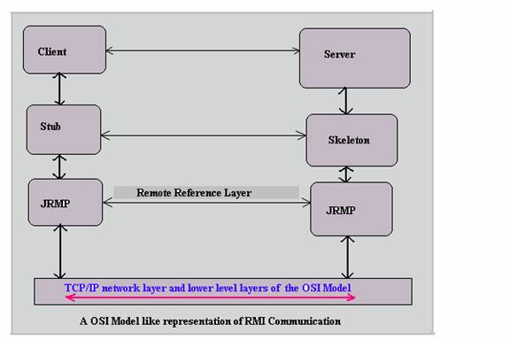
Stubs & Skeletons
Client Stub: Java Object residing on the client’s machine which acts as a proxy for the object residing on the server. It contains all the methods that the server object has.
Server Skeleton: stub’s counter part on the server. It knows which object’s method is being invoked.
Notes:
The diagram above describes the RMI architecture on the lines of the OSI model. Suppose that there is a server object and a client object on two different machines. Let us further assume that the client object wants to invoke a method on the server object. To do this the client will need a reference to the object living in the server. Since both client and server are residing on different machines (different JVMs to be precise), an object reference on the server’s host is meaningless on the client’s host. This is where the client stub comes into picture. A client stub is another java object residing on the client’s machine (details of how this stub object finds it’s way to the client machine will come later) which acts as a proxy or surrogate for the object residing on the server. This means that the stub will contain all the methods that the server object has. However the stub’s implementation of these methods will be different from the implementation of these methods on the server object. Specifically, the stub’s implementation will be defined so as to pass the method arguments to the server through the Remote reference Layer via the transport protocol to the server. Since we are talking about java objects, the arguments and return types can be either primitive data types or objects. If they are objects, the stub must necessarily serialize all objects so that they can be sent over the network. Also the stub must be able to pass enough information to the skeleton (which is the stub’s counter part on the server) so that the skeleton knows which object’s method is being invoked. On the server side the server skeleton receives the request to invoke a method on the object actually residing in the server, formats the arguments into a valid method call and invokes the method on the object. If the method returns some value, this is returned via the same channel to the client, where the stub in turn returns this value to the client object. As far as the client object is concerned, it has transparently invoked a method on the server successfully. This process of collecting method arguments invoked on the stub and converting into a stream suitable for transport over the network is known as marshalling. Reconstructing a method call from a network data stream in its entirety is called un-marshalling.

Slide 36
The java.rmi.Remote interface
RMI provides an interface called Remote. This is contained in the java.rmi package.
If a class wants its objects to be accessible remotely, that class must implement this interface.
Thus we call an object a Remote Object if it is accessible remotely.
The Remote interface is an empty interface having no methods. It is a tag interface that tells the Java runtime that objects of this class are remotely accessible.
To make this class have its methods remotely accessible, the methods need to be declared in an interface that extends the Remote interface.

Slide 37
Using the java.rmi.Remote interface
The exact steps needed to do this are:
Declare an interface that extends java.rmi.Remote
Declare methods that need to be accessed remotely
All Remote methods must throw java.rmi.RemoteException
Define a class that implements this interface.

Slide 38
1. Extend RMI
Declare an interface that extends java.rmi.Remote:
public interface MyInterface extends java.rmi.Remote

Slide 39
2. Declare methods that need to be accessed remotely
public interface:
MyInterface extends java.rmi.Remote
{
//Declare all methods here
public String getMessage()throws java.rmi.RemoteException;
//More methods
}
Notes:
All Remote methods must throw java.rmi.RemoteException

Slide 40
3. Define a class that implements this interface
public class MyClass implements MyInterface
{
//Variable definitions/Declarations
//Constructors
//Other methods
public String getMessage()throws RemoteException
{
return new String(“Hello there!”);
}
}
Notes:
Now objects of this class, when passed as arguments in a remote method invocation are passed by reference and not by value. But How does a client find this object residing on some machine on the network?. An analogy of a library book shelf will help.
In a library , books are arranged on shelves according to certain rules, and, guidelines to locate books are provided to users. A user aware of these guidelines can locate a book quite easily.
In our discussion, the objects that we create of classes that implement Remote are like books. We need to put them in a place where a user can access them This place is the RMI registry. We name each of the objects we create and put the objects in the RMI registry. This process is called binding. Once an object is bound to this registry, a client can query this registry (known as looking up) for an object using the name of the object. The RMI registry is actually a naming service, in the sense that it locates objects bound to it and returns a reference to that object to any client that queries it. Having obtained the remote reference, the client can invoke methods on the remote object. Since the client always looks up the RMI registry for remote objects, it does not matter where the actual object is actually executing. This mechanism provides the location transparency that we talked about earlier. While looking up the client uses a simple URL formatted string to look up the object.

Slide 41
Registry
Now objects of this class, when passed as arguments in a remote method invocation, are passed by reference and not by value. But How does a client find this object residing on some machine on the network?
An analogy of a library bookshelf will help.
In a library, books are arranged on shelves according to certain rules, and guidelines to locate books are provided to users. A user aware of these guidelines can locate a book quite easily.
In our discussion, the objects that we create of classes that implement Remote are like books. We need to put them in a place where a user can access them. This place is the RMI registry.

Slide 42
Bind
We name each of the objects we create and put the objects in the RMI registry. This process is called binding. Once an object is bound to this registry, a client can query this registry (known as looking up) for an object using the name of the object.
The RMI registry is actually a naming service, in the sense that it locates objects bound to it and returns a reference to that object to any client that queries it. Having obtained the remote reference, the client can invoke methods on the remote object.
Since the client always looks up the RMI registry for remote objects, it does not matter where the actual object is actually executing. This mechanism provides the location transparency that we talked about earlier. While looking up the client uses a simple URL formatted string to look up the object.

Slide 43
Comparison
CORBA
Java RMI
Object Request Broker
Multi-language support (platform independence)
Interface Definition language
Java only
Lightweight method call semantics
Java Implementations
Both try to preserve object semantics. Interface/Implementation separation

